Slide 1
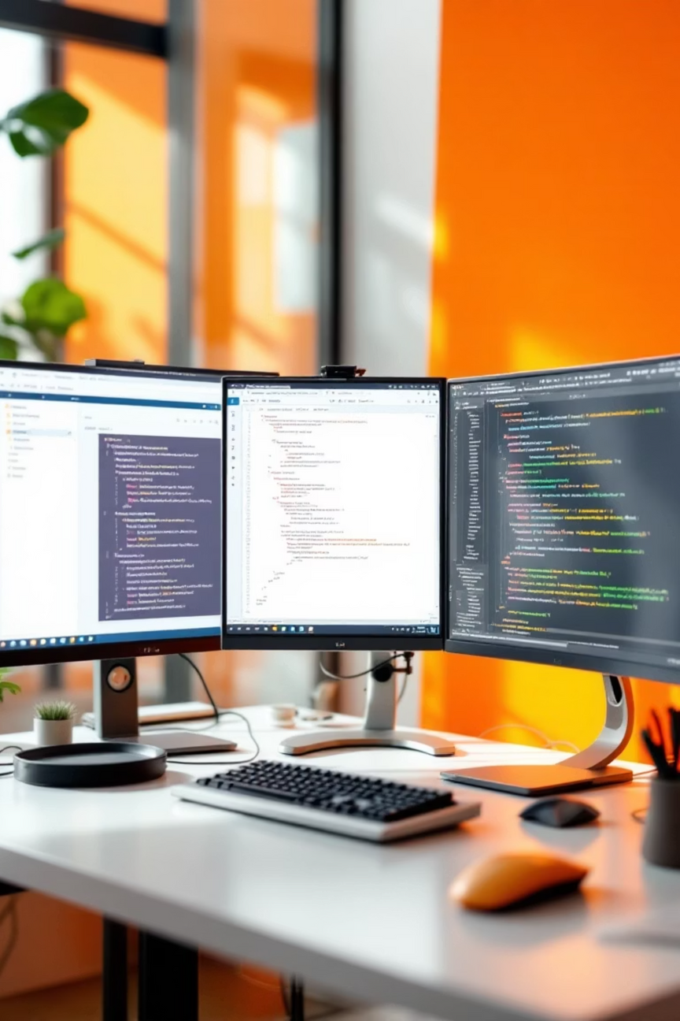

Foundation of Web Development
Welcome to the comprehensive journey through web development fundamentals. We'll explore the three core technologies that power every website and web application you interact with daily.
CHANDRU.S
24524U18017
KARAN ART'S SCIENCE COLLEGE
THIRUVANNAMALAI

Slide 2

HTML: The Building Blocks
HyperText Markup Language
HTML forms the structural foundation of every webpage. Think of it as the skeleton that defines content organisation and meaning.
Defines webpage structure and content
Uses tags to mark up elements
Creates semantic meaning for browsers
Foundation for accessibility features
Notes:
2

Slide 3
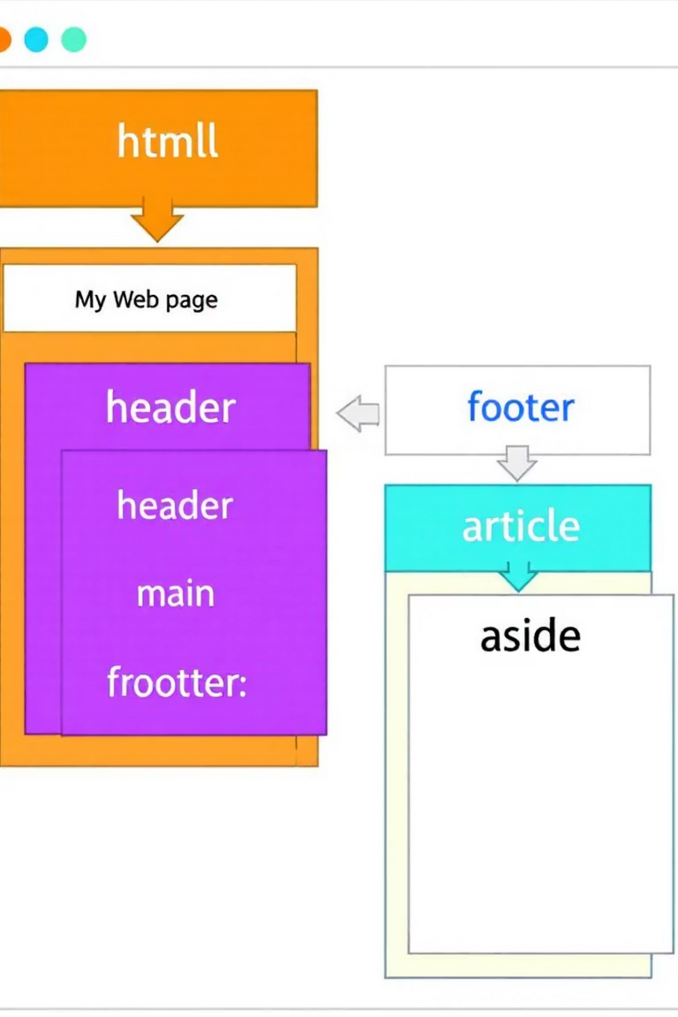
HTML Document Structure
01
Document Declaration
DOCTYPE declaration tells the browser which HTML version to use
02
HTML Root Element
The <html> tag wraps all content on the page
03
Head Section
Contains metadata, links to stylesheets, and page title
04
Body Content
Houses all visible content including text, images, and interactive elements
Notes:
3

Slide 4
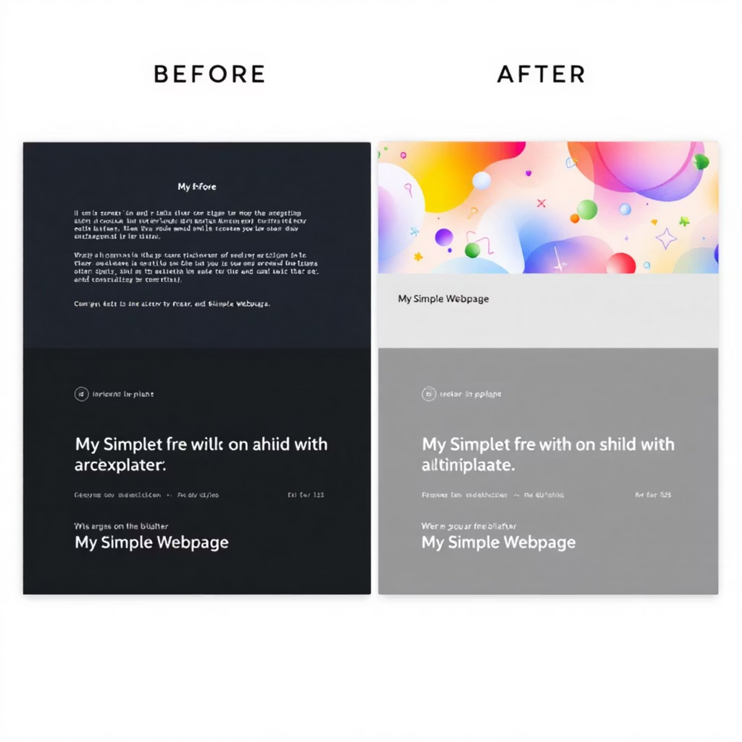
CSS: Bringing Style to Life
Cascading Style Sheets
CSS transforms plain HTML into visually appealing, responsive designs. It separates content from presentation, enabling consistent styling across entire websites.
Visual Design
Colours, fonts, spacing
Layout Control
Positioning, flexbox, grid
Notes:
4

Slide 5
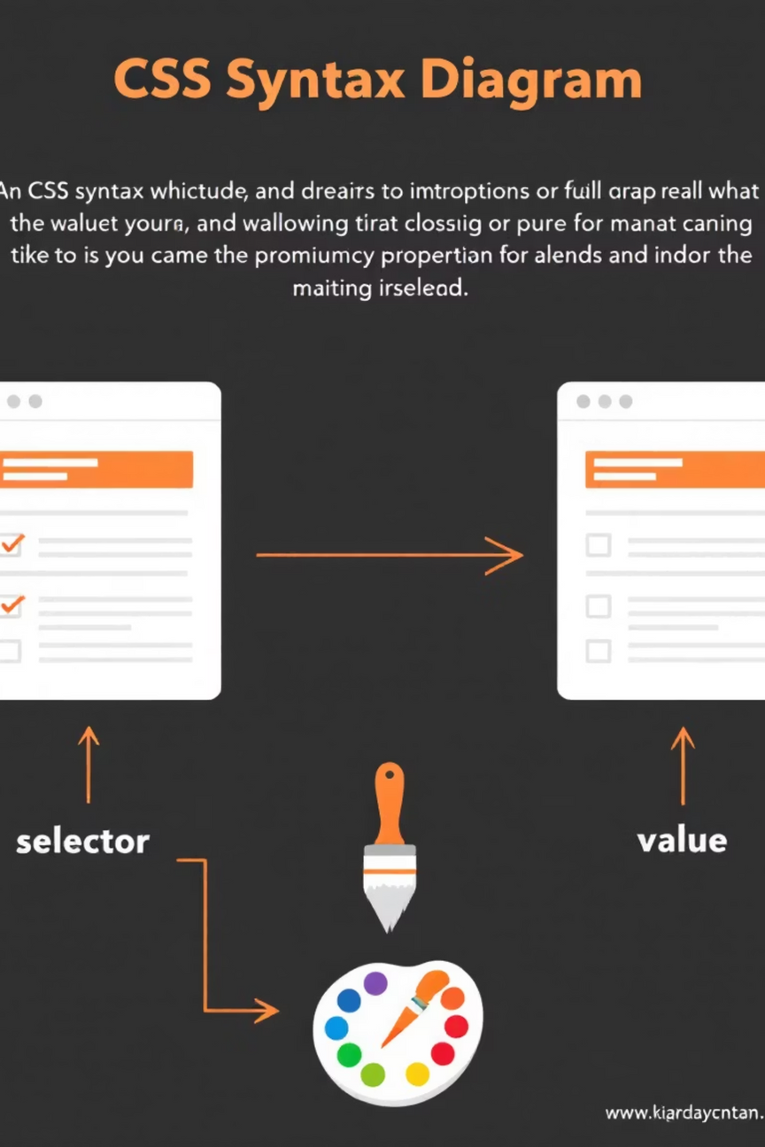



CSS Syntax Structure
Selector
Identifies which HTML elements to style (e.g., h1, .class, #id)
Property
Specifies what aspect to change (color, font-size, margin)
Value
Defines how the property should appear (blue, 16px, 10px)
Notes:
5

Slide 6

CSS Styling in Action
h1 { color: #E04F00; font-size: 32px; text-align: center; margin-bottom: 20px;}.button { background-color: #E04F00; padding: 12px 24px; border-radius: 8px; color: white;}
This CSS code creates an orange heading and matching button, demonstrating how properties work together to create cohesive design elements.
Notes:
6

Slide 7




JavaScript: Adding Interactivity
Dynamic Behaviour
Programming Logic
Makes webpages interactive and responsive to user actions
Handles calculations, data processing, and decision-making
Real-time Updates
Updates content without requiring page reloads
Notes:
7

Slide 8



JavaScript Key Features
Event Handling
Data Manipulation
Cross-platform
Responds to user interactions like clicks, scrolling, and form submissions, creating dynamic user experiences.
Processes and transforms data, manages variables, and performs complex calculations in real-time.
Runs on browsers, servers, mobile apps, and desktop applications, making it incredibly versatile.
Notes:
8

Slide 9

JavaScript in Practice
Simple Interactive Example
Common Applications
function changeColor() { let element = document.getElementById('myButton'); element.style.backgroundColor = '#E04F00'; element.innerHTML = 'Clicked!';}// Usage in HTML<button onclick="changeColor()"> Click Me</button>
Form validation and submission
Image sliders and carousels
Shopping cart functionality
Interactive maps and charts
Single-page applications
Notes:
9

Slide 10






The Perfect Trinity
CSS
Presentation
Controls visual appearance and layout design
HTML
Structure
Defines content hierarchy and semantic meaning
JavaScript
Behaviour
Adds interactivity and dynamic functionality
Together, these three technologies create the complete web development foundation. HTML provides structure, CSS adds visual appeal, and JavaScript brings everything to life with interactivity.
Notes:
10

Slide 11
Notes:
THANK YOU

